Slide 1

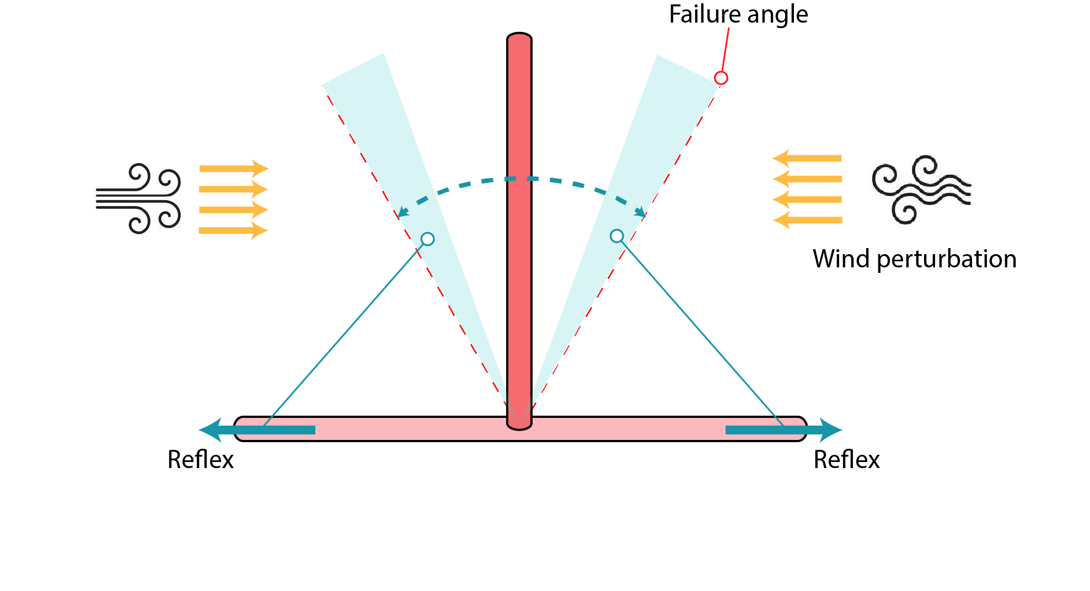


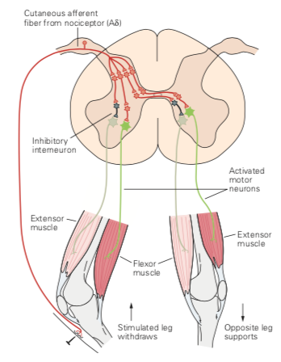
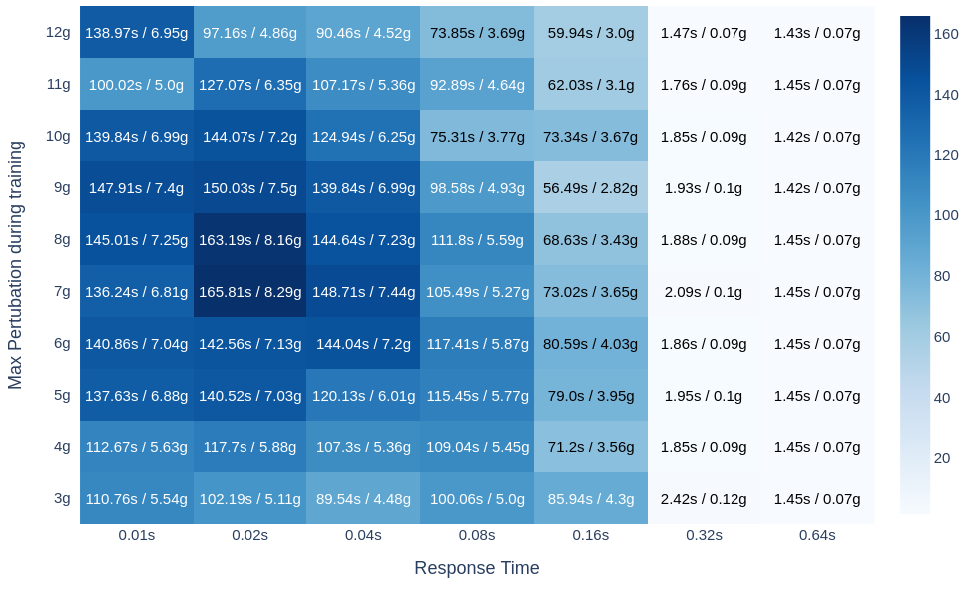
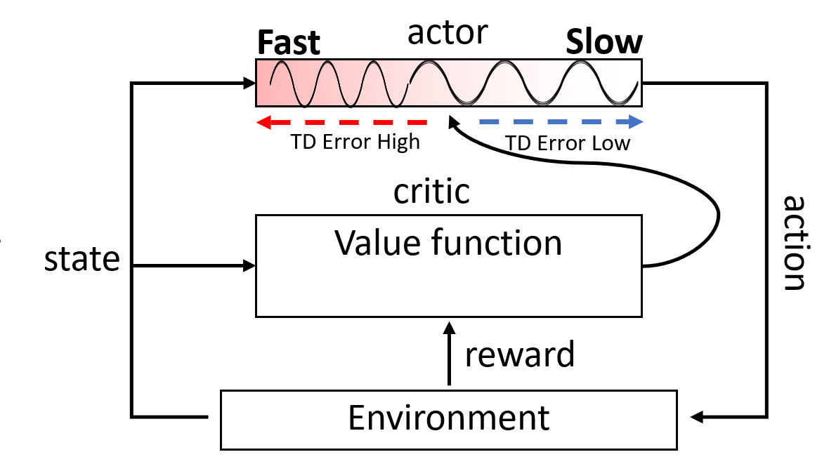
Robust Control in Real Time Reinforcement Learning Using Adaptive Response Times
Devdhar Patel¹, Francesca Walsh¹, Zhongyang Zhang¹, Tauhidur Rahman¹, Terrence Sejnowski², Hava Siegelmann¹
¹University of Massachusetts Amherst, Amherst MA
² Salk Institute for Biological Studies, La Jolla, CA
Introduction
In a real-time environment, there is delay between the input and actuation.
We modified the inverted pendulum task to add a horizontal perturbation force of random intensity, direction and at random times.
For standardized evaluation, perturbation was added every five seconds of increasing intensity until the agent failed.
We augmented a feed forward neural network with a fast three-neuron reflex loop so that the reflex can react faster than the original network.
The reflex is not learned and is hardcoded.
Task: Modified Inverted Pendulum
Real-time RL
Environment simulation
Environment paused
Agent Processing
Environment simulating
Traditional RL
s₀
a₀
s₁
a₁
s₂
a₂
Our Biologically Inspired Reflex Architecture
s₀
a₀
s₁
a₁
s₂
a₂
Results Overview
The optimal response time differs based on the environment and constrains such as memory, network capacity and energy.
When augmented with reflexes, the network is more robust to perturbation and survives longer in the environment.
Slower networks with reflex outperform faster networks without reflexes saving compute, memory and energy.
Fast Reflex: three neurons
Input
s₀
a₀
s₁
a₁
s₂
a₂
s₃
Slow response
No action
a₀
a₁
a₂
s₁
s₂
s₃
Biological Reflex Loop – Leg Withdrawal from Nociceptive Stimuli
Response Time vs Performance
 | Seconds survived (Decisions made)
Res. speed | 0.16s | 0.08s | 0.04 | 0.02 | 0.01
w/o Reflex | 83.81 (534) | 109.21 (1366) | 127.8 (3195) | 152.68 (7634) | 138.4 (13840)
Reflex | 107.72 (674) | 129.14 (1618) | 132.23 (3306) | 159.63 (7982)
Future work: Modulate response time using TD-error (Dopamine)
Future work:
Integrate reflexes into adaptive actor-critic architecture where the actor’s response time is modulated by the critic using the TD-error (Dopamine).
High TD-error results in a surprise which causes the actor to increase its response speed and pay more temporal attention.
Low TD-error causes boredom and allows the actor to decrease its speed thus reducing temporal attention and saving energy.
Diagram adapted from Kandel et. al (2015) p.763

